Slide 1
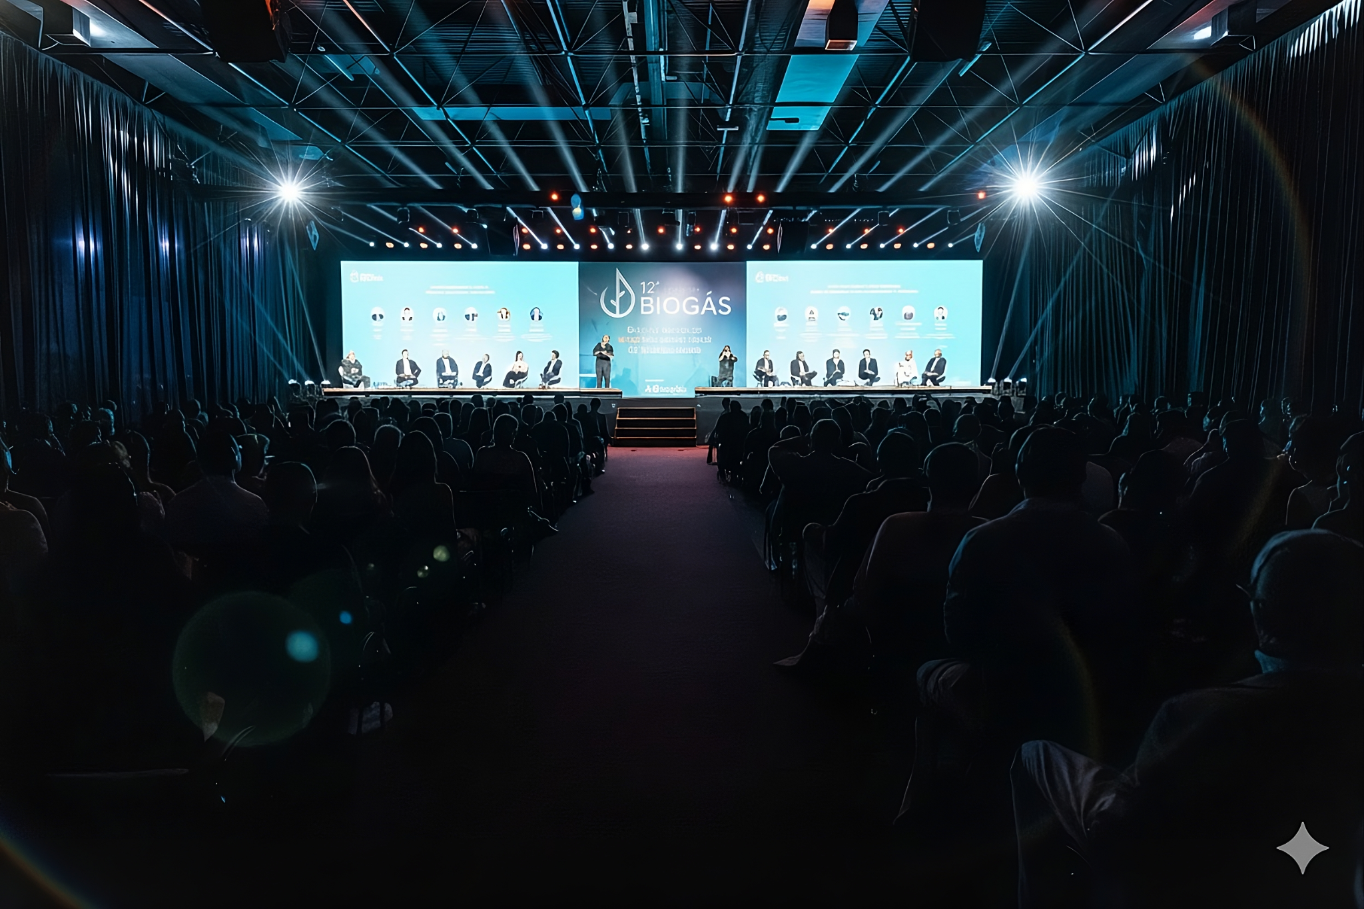




O ponto de encontro internacional de investidores em BIOGÁS e BIOMETANO
Air pollution control in biogas to Biomethane processing
DÜRR CTS Brazil Ltda.
By Joachim Uwe Lorenzen

Slide 2
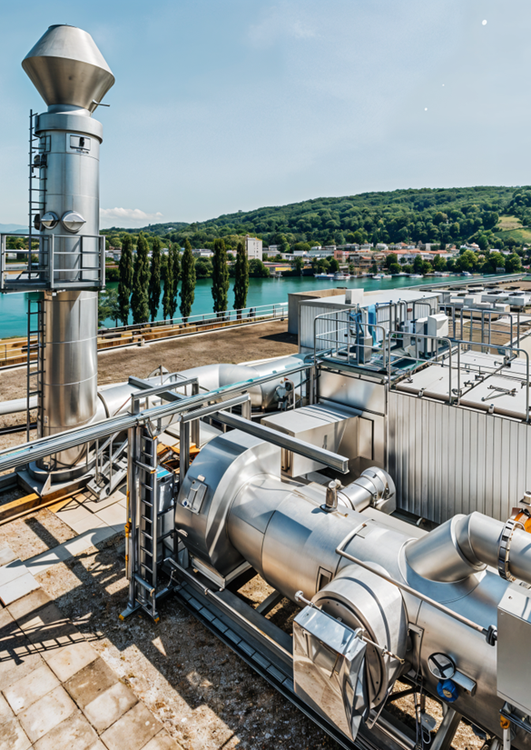



DÜRR CTS
Clean Technology Systems at a glance
1
With six decades of global experience, Clean Technology
Systems are leading experts for air pollution control, noise
abatement and decentralized power generation.
€0.407 bn
revenue
1,300
employees
16 locations in
12 countries
We provide state-of-the art and custom-engineered solutions
for key industries, such as chemicals, surface treatment, automotive, power generation, oil & gas and many more.
1 Figures from 2024

Slide 3
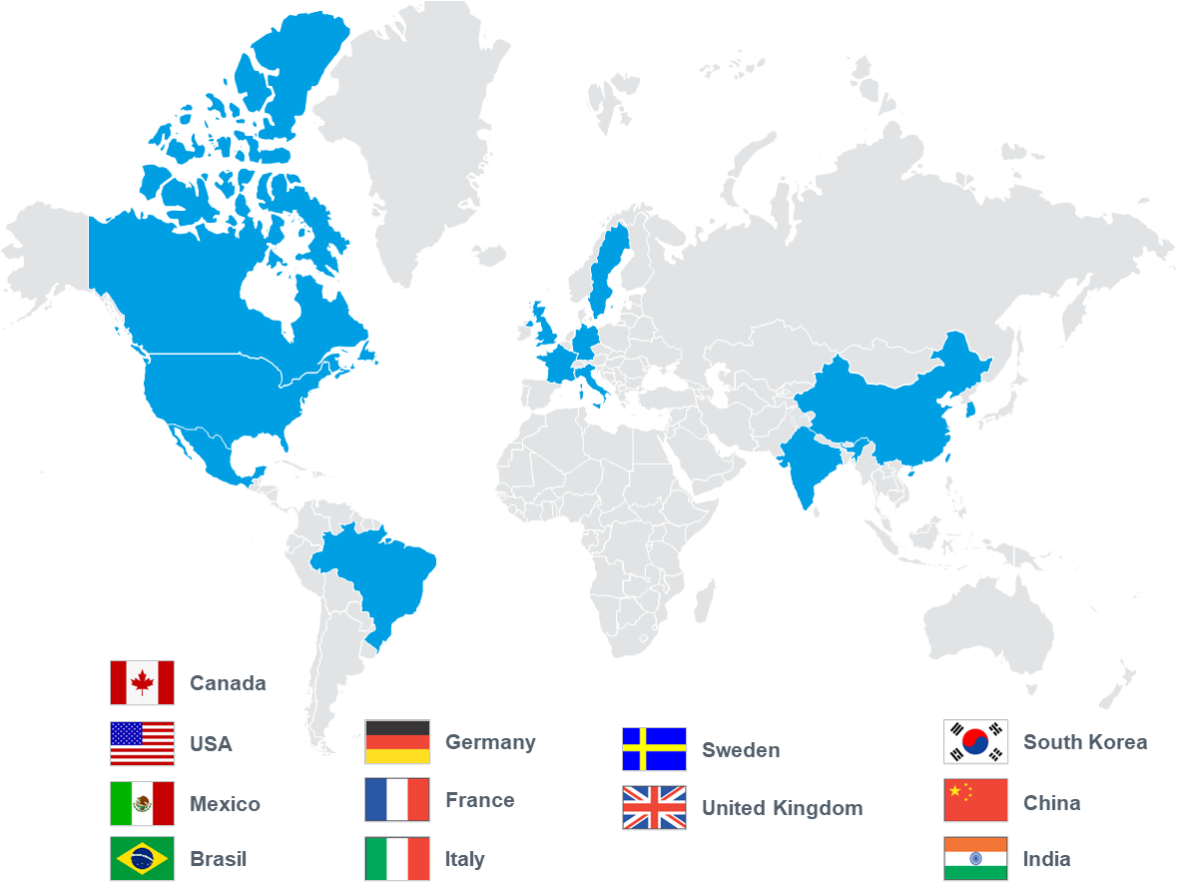
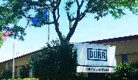



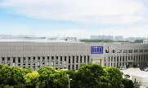
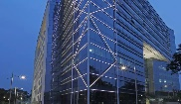


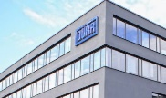

DÜRR CTS
Global presence – close to our customers
Manufacturing facilities
De Pere, WI, USA
San Luis Potosi, MX
Shanghai, China
Pune, India
>45,000
Sqm of dedicated
manufacturing floorspace
R&D centers
Bietigheim, Germany
De Pere, WI, USA
Dedicated R&D experts, focused on new product opportunities

Slide 4
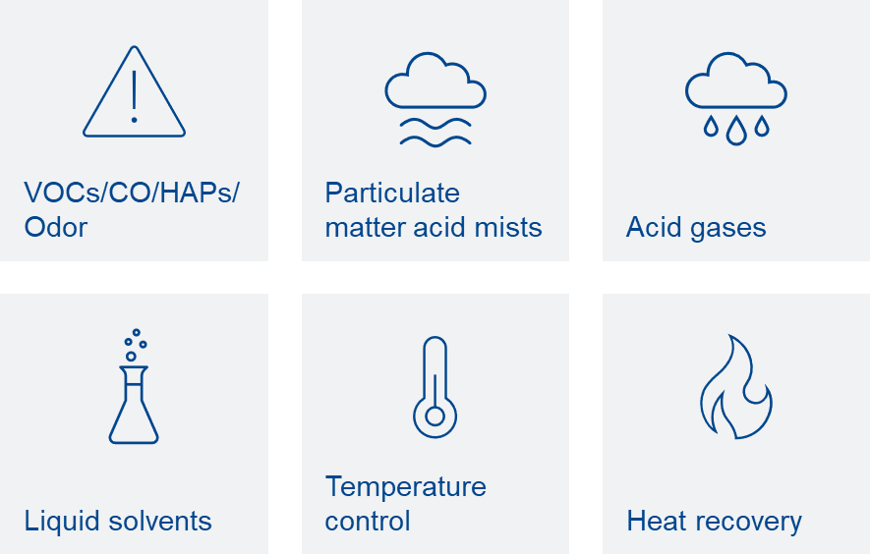
Prepared to master every challenge
DÜRR CTS
Multi-pollutant emissions control
Let us manage your environmental compliance,
so you can stay focused
on your business.
We combine our technical expertise with global availability to support our customers throughout the world, offering solutions for multiple pollutants – from a single-source.

Slide 5
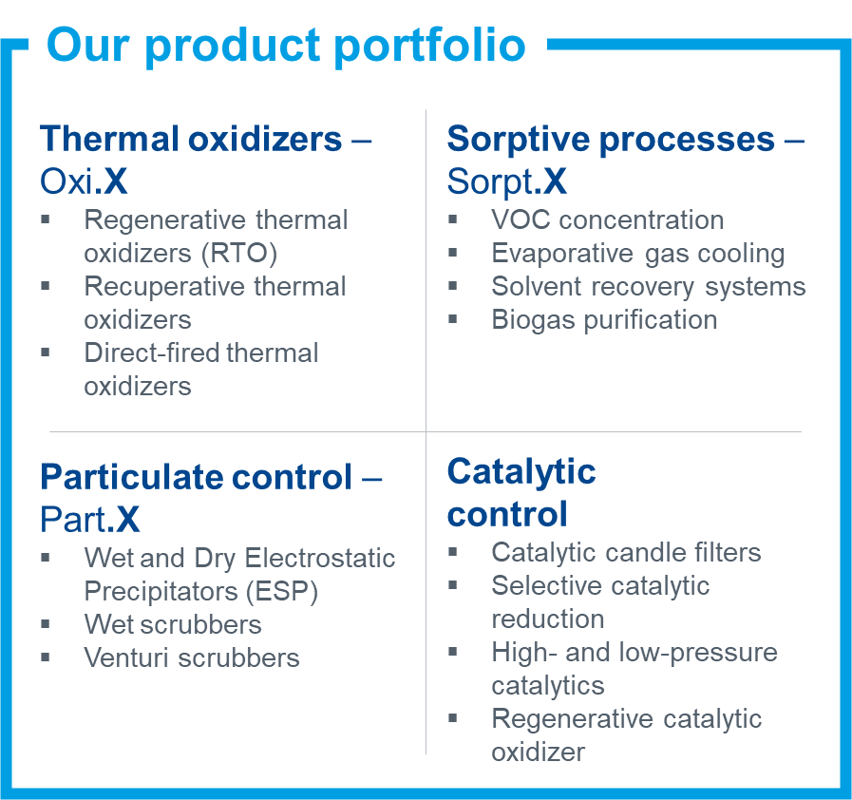




Air pollution control
DÜRR CTS
Key segments and products
Innovative solutions for major industrial
sectors and applications
Chemicals
Automotive
Surface treatment
Biomethane
Odor control
Further applications

Slide 6
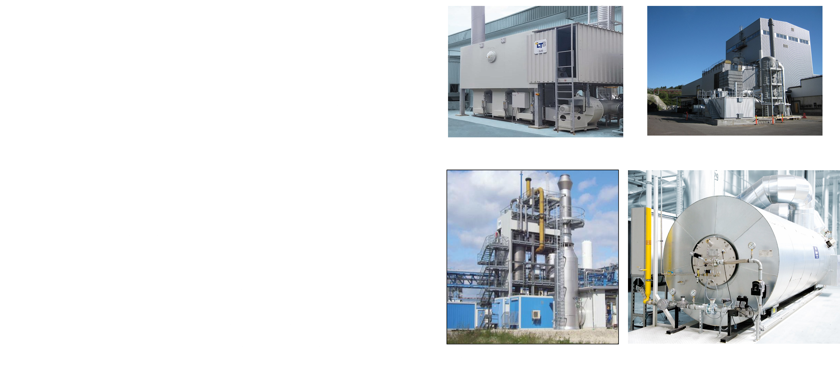
Greener Biomethane and Greener Energy with
DÜRR CTS

Slide 7
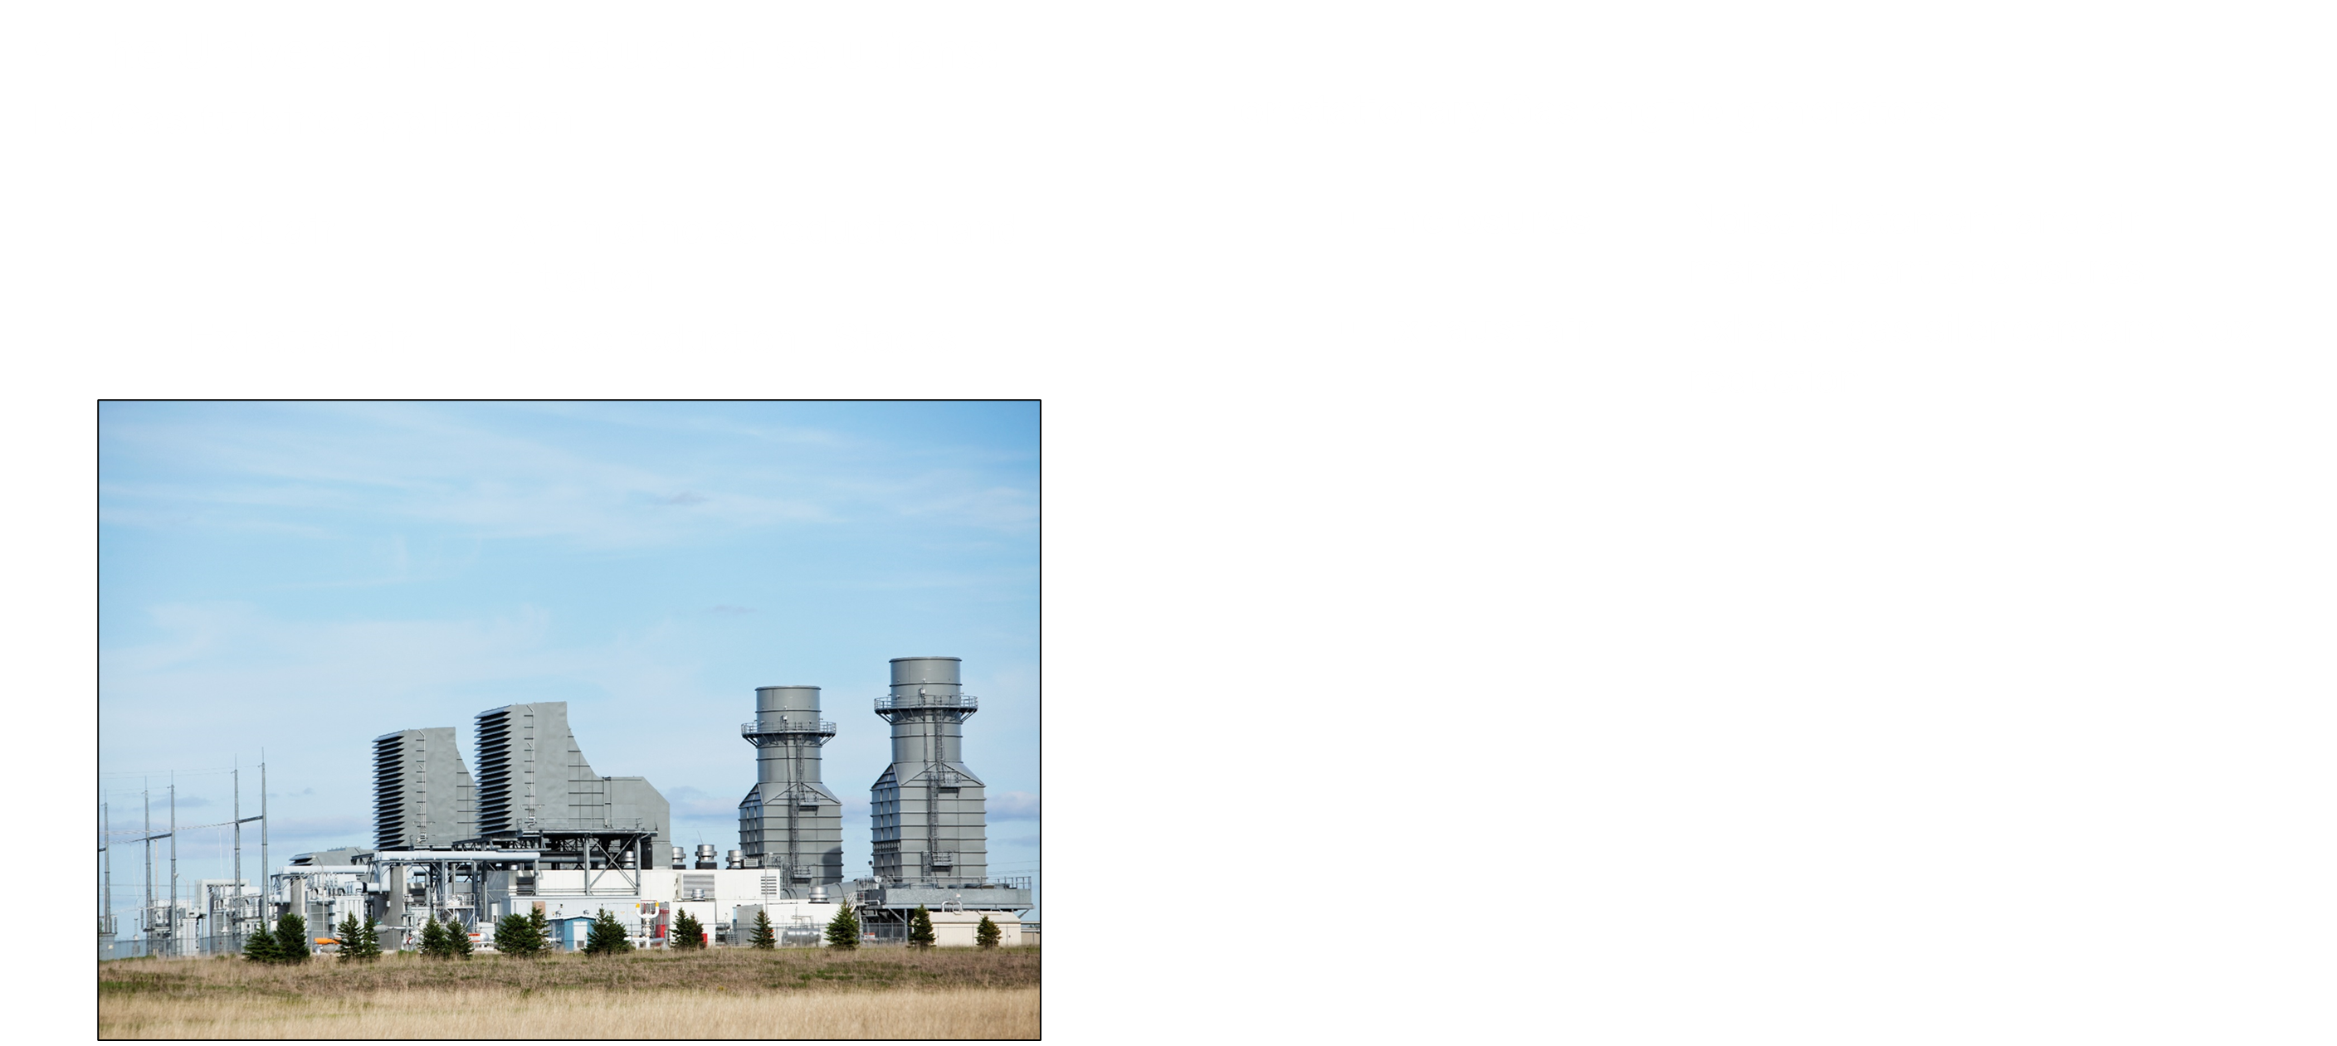
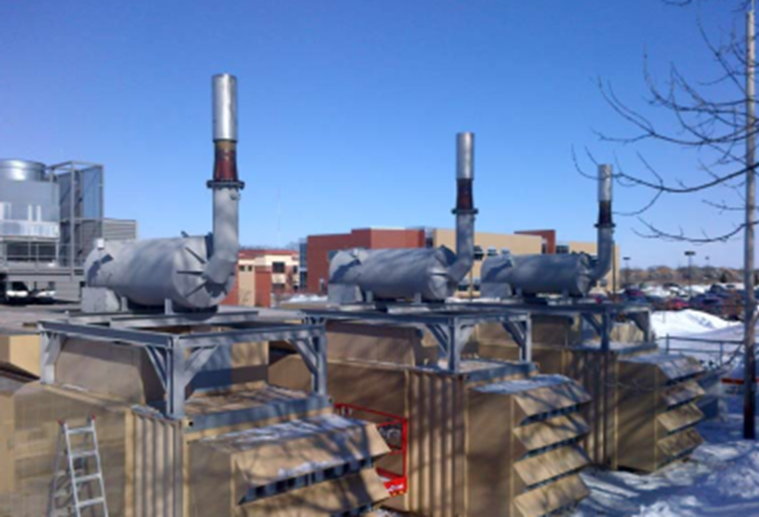
Silence Biomethane application with
DÜRR CTS

Slide 8
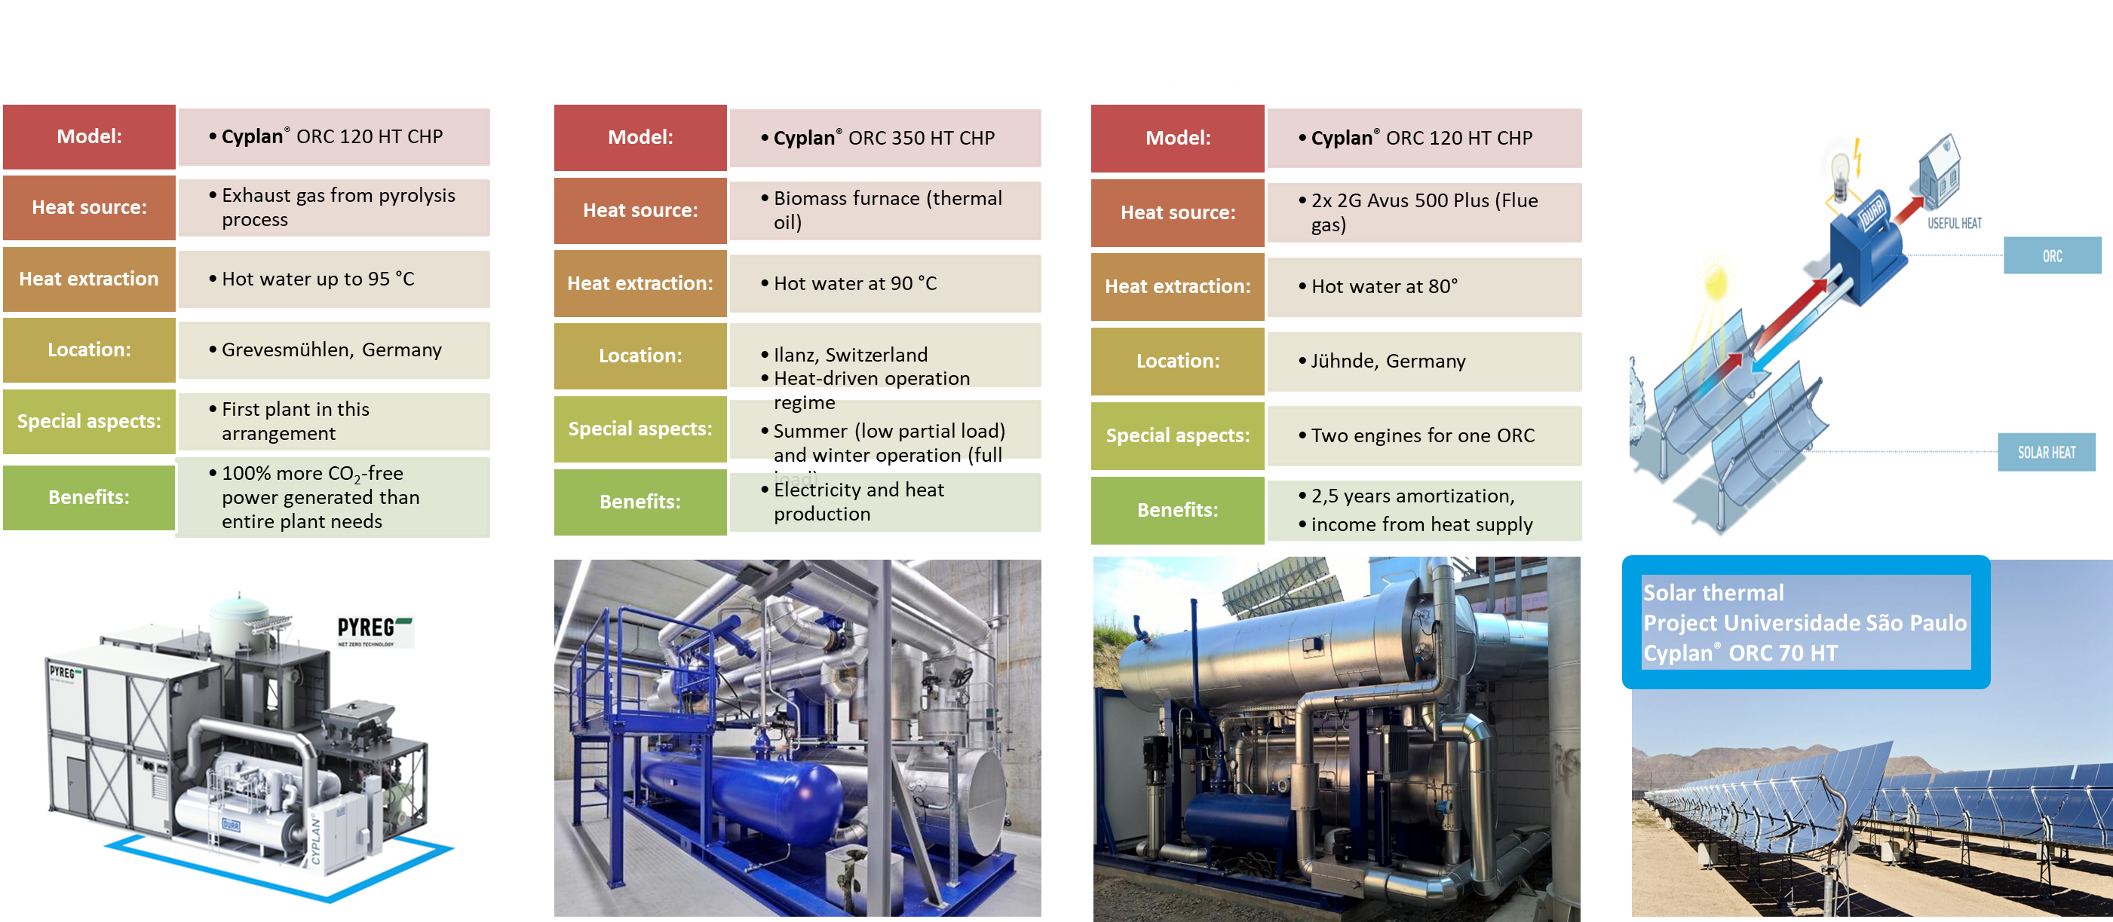
Energy recovery with Cyplan® ORC solutions
DÜRR CTS

Slide 9
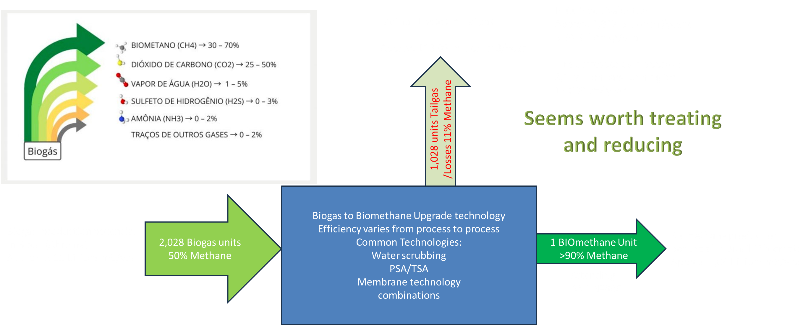
How green is Biomethane in Brazil?
DÜRR CTS
ABREMA: Potencial Production from Landfill waste in Brazil: 1 Billion m³/year

Slide 10
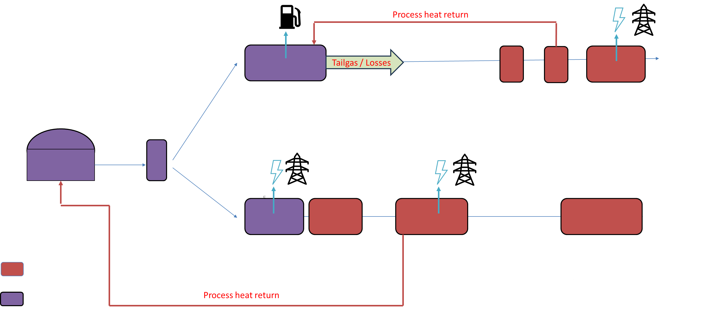
Greener Biomethane and Greener Energy with
DÜRR CTS

Slide 11
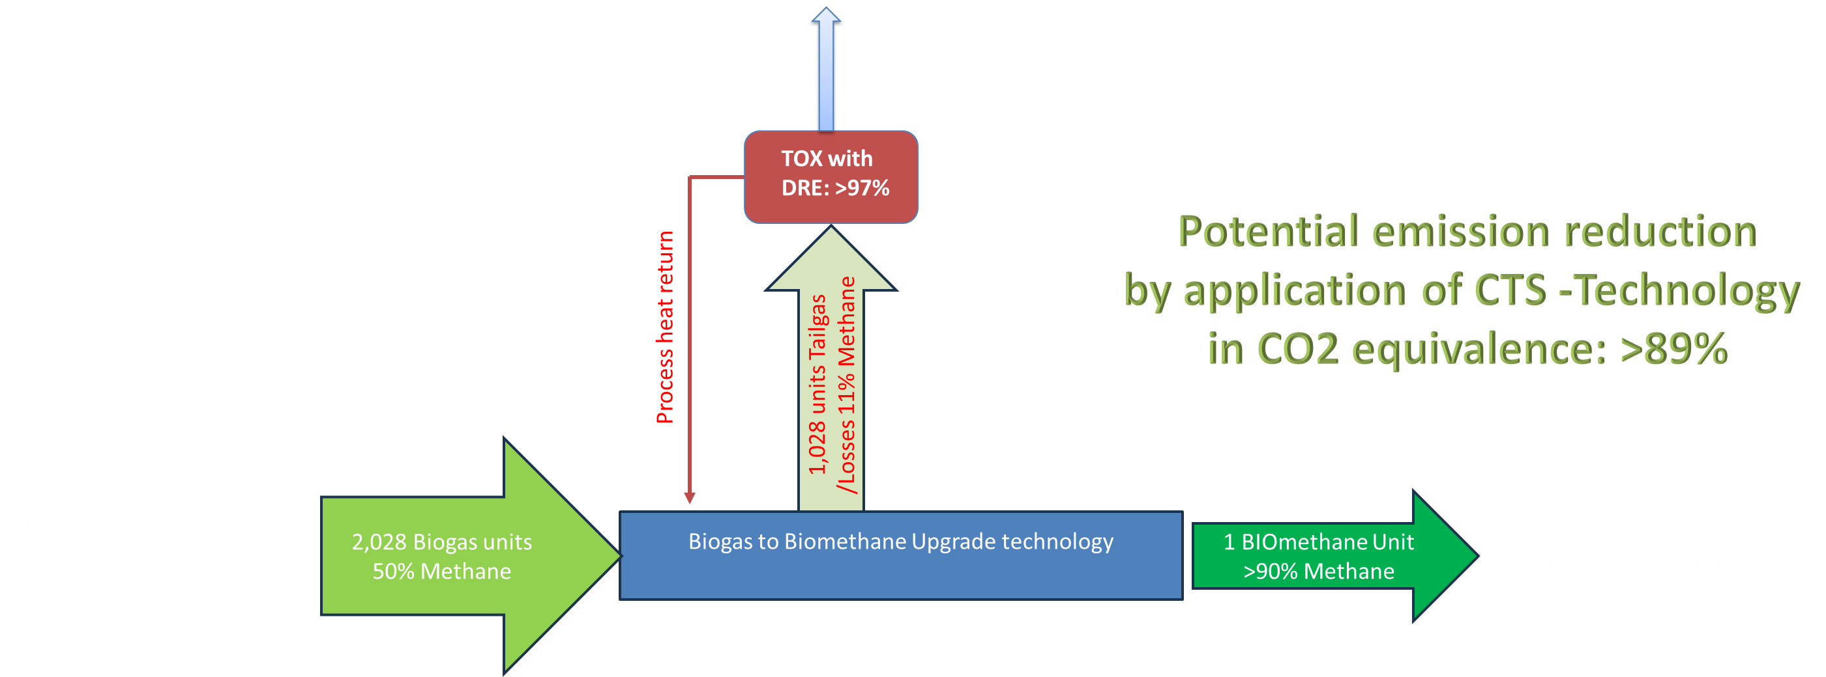
Greener Biomethane and Greener Energy with
DÜRR CTS
CO2 purification
ABREMA: Potencial Production from Landfill waste in Brazil: 1 Billion m³/year

Slide 12
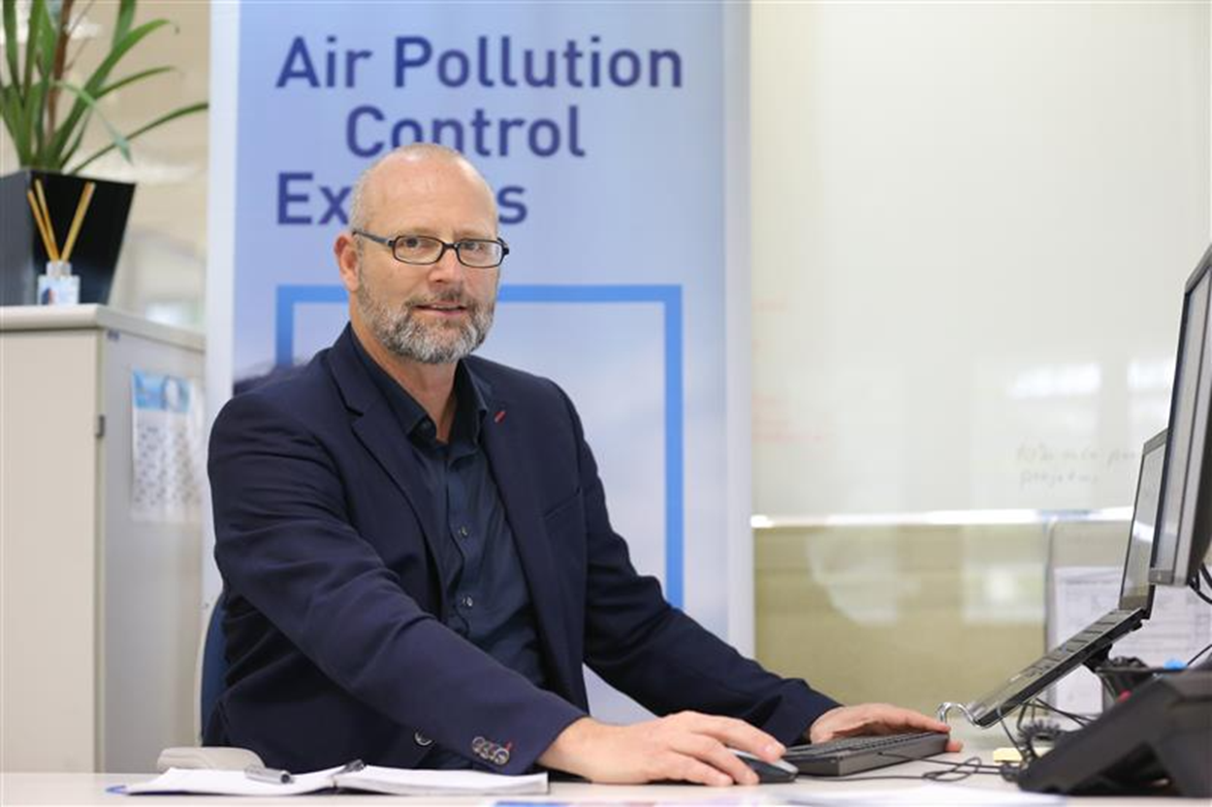
Greener Energy with CTS Technology
DÜRR CTS
Thanks for your attention !
Joachim-Uwe Lorenzen
CEO DURR CTS Brazil Ltda.
Tel.: +55 11 989316549
E-mail: Joachim.Lorenzen@cts-durr.com

